Slide 1
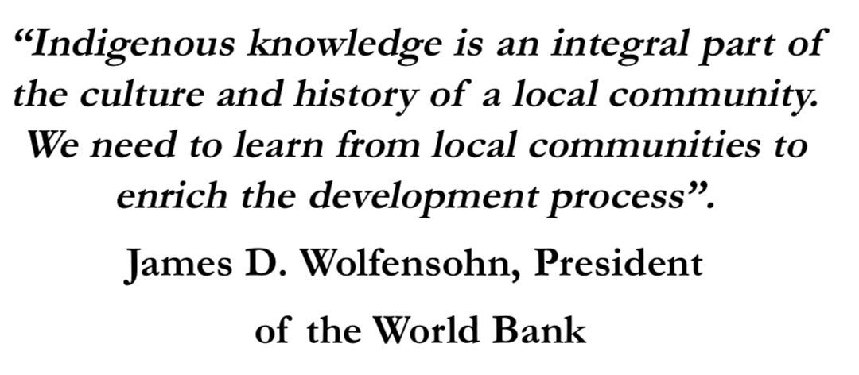
Relevance of Indigenous knowledge, Appropriate technologies and local resources

Slide 2
Indigenous Knowledge
Indigenous knowledge is valuable knowledge that has helped local communities all over the world survive for generations.
This knowledge originates from the interaction between members of the community and the environment in which they live.
Although much has been written about indigenous knowledge, its documentation in the area of disaster risk reduction and climate change has been very limited.
The wealth of this knowledge has not been well-recognised in the disaster risk reduction field, as policy-makers still rely on mitigation strategies based on scientific knowledge.
Colonialism and lack of proper documentation of indigenous knowledge are some of the contributing factors to this.
Ignoring the importance of understanding adaptive strategies of the local people has led to failed projects.

Slide 3
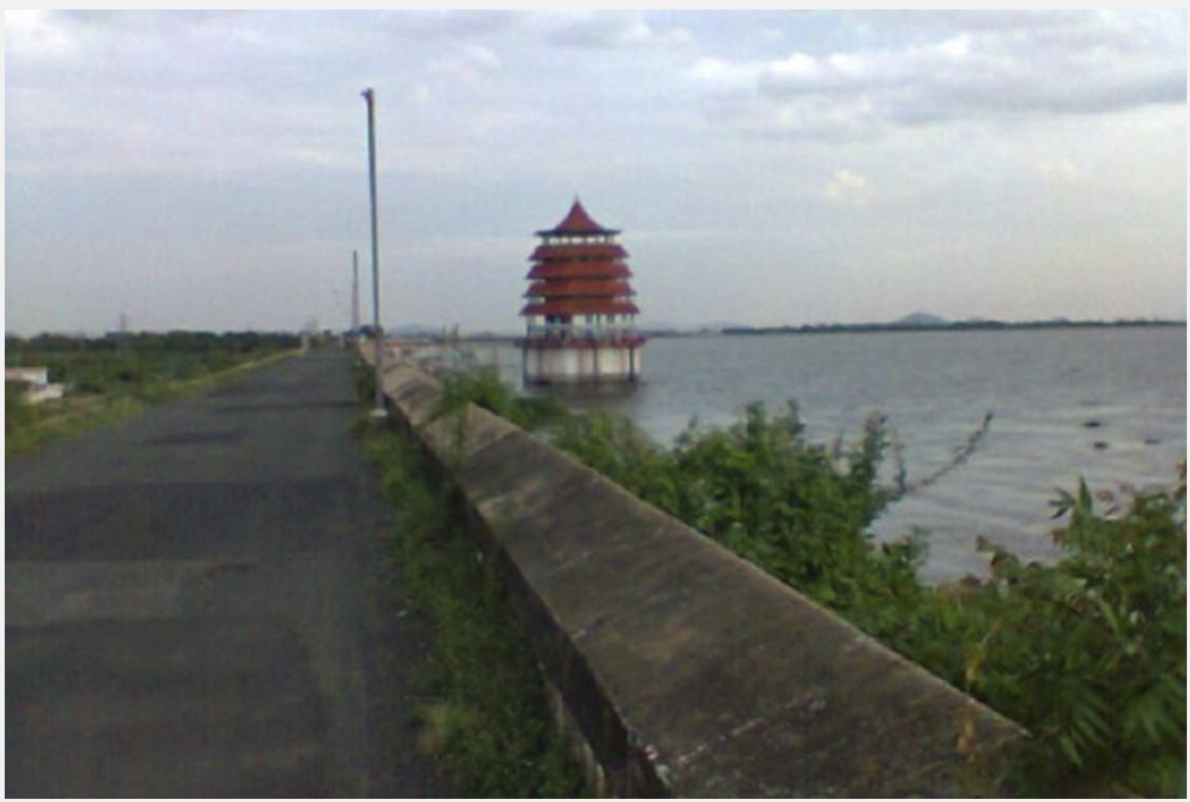
Example:Chennai Floods
During heavy rains, when the water level is close to full capacity, water is released into the river.
Chembaramkabbam Lake is a rain-fed reservoir which supplies water to Chennai city through pipelines.
When too much water is released in a short period, Adyar River overflows, flooding residential areas and other parts of Chennai.
There was no history of severe floods in Chennai.So the people did not have any traditional knowledge of the effects of the flood.But now after this flood,the people obtained knowledge about the defects in the construction of buildings and dams.
This information will be passed to the future generations which will save them from high damage we faced due to lack of knowledge.
First, we need to understand the Adyar River, Chembarambakkam
Lake and how they are connected to Chennai’s flooding.The Adyar
River originates from a tank near Manimangalam village in
Sriperumbadur in Kanchipuram district, but it is only when the
water from the Chembarambakkam lake joins the river that the stream
appears. The river then flows through Tiruvallur and Chennai and
flows into the Bay of Bengal at Adyar in Chennai.

Slide 4
Why Local Knowledge is Important?
Since the 1970s, evidence that local knowledge and practices can help implementing organisations to improve disaster preparedness activities has grown.
Despite advances in knowledge and technology (e.g., satellite coverage or surveillance techniques), vulnerability to and the risks from natural hazards have been rising in developed and developing countries
The increase in risks and vulnerability is the result of changes in people’s social, economic, cultural, political, and environmental contexts.
For example, development processes (e.g., dams and road construction) have affected the allocation and distribution of resources between different groups of people and have created new natural hazard risks. When people are displaced, the poorest among them are forced to settle on marginal land and in risk-prone areas because of demographic and socioeconomic pressures.
Taking local knowledge into consideration in terms of practices and contexts can help implementing organisations improve their planning for and implementation of disaster preparedness activities; and it can help improve project performance and project acceptance, ownership, and sustainability specifically.

Slide 5
Financial View
Economies of scale are based on the assumption that people perform better on some scales than on others and that different resources are found on different scales
Solutions in resource management, development, and disaster management need to go beyond the dichotomy between local versus state management levels and integrate cross-scale institutional linkages.
Understanding local knowledge and practices can help identify what is needed and acceptable locally and how people’s participation can be solicited to ensure their support for external action.
Building on local knowledge and practices (i.e., capitalising on local strengths), when it is relevant to do so, can decrease dependency on external aid. Local people provide continuity and can monitor the actions taken.

Slide 6
Social View
Taking local knowledge and practices into account promotes mutual trust, acceptability, common understanding, and the community’s sense of ownership and self-confidence.
Understanding local knowledge, practices, and contexts helps development and research organisations to tailor their project activities and communication strategies to local partners’ needs.
It also enables development research organisations to act as intermediaries in translating messages from government level to communities in a way that is understandable and credible.
For example, a meteorological agency might release the following message to communities: “the river is going to rise by one to two metres in the next 24 hours.” But is it enough? What does it mean to the locals? Government agencies often release information that is not understood at local level
In the Ambae Island, Vanuatu, describe how depictions of volcanic hazard on a map could not be understood locally, because the community had a different perception of the landscape from that of the mapmakers.
Hence, communication tools for disaster preparedness, such as official warning messages or hazard maps, need to incorporate local references.

Slide 7
Knowledge Types
Aside from local, technical knowledge, there are other types of knowledge such as environmental and agricultural knowledge, sociocultural knowledge, and historical knowledge. This local, non-structural knowledge is not easily identified by outsiders, because it is closely embedded in people’s livelihoods and worldviews.
Environmental and agricultural knowledge or ecological knowledge is the most intensively studied and refers to local knowledge of natural resources . Studies have highlighted the richness of local environmental knowledge (e.g., soil classification, land-use categories, and weather patterns) and have shown how local methods, such as agroforestry and polyculture, contribute to conservation of ecological diversity.
Sociocultural and historical knowledge is often ignored by studies of natural disasters, despite its importance . Sociocultural knowledge includes knowledge related to the sociocultural environment in its broadest sense, viz., social, political, economic, and spiritual aspects of life . According to Ellis and West (2000, p 13), it can be argued that local knowledge is embedded within both the historic understanding of (natural hazards and disasters) and current actions and events. Local history about social relations is important because it can influence the way people perceive and respond to natural hazards.
Knowledge about development projects refers to people’s beliefs about the outside world (the regional, state, and international actors likely to intervene in disaster responses) which affects how they respond to interventions.

Slide 8
What Influences Local Knowledge?
Many external and internal barriers exist that have prevented local knowledge and practices from being exercised in mainstream institutions working on disaster management.
Until today, natural hazards and disasters are mainly conceived as an issue for national defence and security, contributing to a failure to decentralise power in this sector.
Another barrier to the use of local knowledge in disaster management is based on the nature of local knowledge itself (dynamic, invisible, complex, diverse, and context-specific in both time and space), which makes it a challenge to identify, understand, and use it.
Power relations :
Power relations refer to the exercise of control over resources, decision-making processes, knowledge creation, transmission, interpretation, and validation.
Power relations partly explain why local knowledge has been ignored by the mainstream literature on disasters and institutions charged with disaster management and especially disaster preparedness.
The nature of control depends upon diverse factors (e.g., sociocultural, economic, political, and ecological), takes various forms (e.g., direct and indirect, formal and informal, discursive and non discursive, and symbolic), and has various degrees of influence throughout time and space (e.g., local and extra-local power relationships).

Slide 9
Good Practices and Lessons Learned from Experiences in the Asia-Pacific Region
According to the Internetonal Strategy pf disaster reduction,Development research tells us that the success and the sustainability of interventions at the community level depend, among a number of factors, on the availability of relevant local culture, knowledge and indigenous practices that can combine with new ideas to generate innovation.
The importance of indigenous knowledge contributes not only to the success of intervention, but more importantly to its sustainability in the longer term
Considering the participation and integration of these communities in all disaster-related processes as a necessary means for pursuing the Hyogo Framework for Action highlights the importance of indigenous knowledge in assisting to mainstream disaster risk reduction policies and practice.
Even before we came up with high technology based early warning systems, or standard operating procedures for response, numerous local communities worldwide have prepared, operated, acted, and responded to natural disasters using indigenous methods passed on from one generation to the next.
The United Nations already considers indigenous knowledge within Priority 3 of the Hyogo Framework for Action, which focuses on education and knowledge.
One of the key activities identified under this priority action focuses on the importance of information management and exchange, and highlights the use of “relevant traditional and indigenous knowledge and cultural heritage” to be shared with and adapted to different target audiences.
In order to fulfill this objective, we all need to understand, acknowledge and respect indigenous knowledge as a valuable source of information and as a key contributor to reducing risk in many parts of the world.

Slide 10
Karez Technology for Drought Disaster Reduction in Turpan, Xinjiang, Northwestern China
Turpan is very dry in all seasons and very hot during spring, summer and autumn. The highest temperature recorded is 47.7°C in summer. High temperature and strong solar radiation result in high annual evaporation amounting to 2800~3000 mm.¹ Turpan is in an inner land with total annual precipitation of only around 16~17 mm. Because of strong evaporation or the evapotranspiration process, precipitation (rain or snow) falling on the slope of the mountain would evaporate or seep underneath sand and soil before it can converge into a stream and reach the flat agricultural area along the foot of the mountain. Surface water is scarce in most areas. Under such tough circumstances, few plants or animals survive.
Karez is a traditional irrigation water system with a long history in Xinjiang area of China which makes use of underground water efficiently.
Most existing Karez systems were mainly constructed between the 17th and 20th century.
In the Turpan district, 1,016 Karez systems still exist of which 686 are operational. The total length is about 3,000 kilometers. The average depth of the underground canal is 20 meters whilst the utmost depth is 90 meters.
At present, modern facilities such as electromechanical wells are integrated into the system.
The structure of a complete Karez system can be complex but its basic structure is essentially composed of four main components: vertical wells, underground canals, surface canal, and small reservoirs (Figure 1).

Slide 11
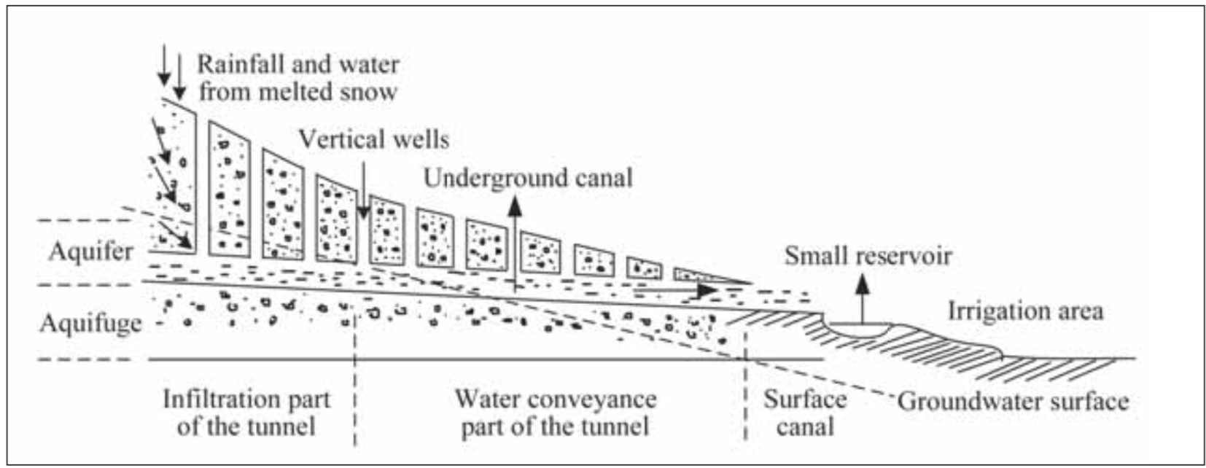
Karez System

Slide 12
VERTICAL WELL:
The length of the underground canal varies from around 3 km to 30 km. It is almost impossible to dig such a long underground canal without digging a vertical well, especially in the past agricultural period when no modern equipment was available.The major functions of vertical wells are for ventilation, proper orientation of the canal during construction and examination and repair of canals after construction.
Underground and Surface Canals:
Of the two types of canals, the majority of them are underground. The canals under the surface are generally part of a network which enables underground water to accumulate. Usually the deep soil around the underground canal is very strong and does not collapse easily. However, when the canal is close to the surface, the soil is loose. To prevent the underground canal from collapsing, it is usually reinforced with wooden pillars. At the bottom of the well, both sides are excavated for the underground canal. When the underground canal reaches the farmland, it becomes a surface canal and is linked to a small reservoir or directly connected to a system of water channels for
Small Reservoir:
Water resources are collected in small reservoirs which can be adjusted for water level and temperature. Constructing reservoirs increase the water level so that a larger area of farmland is irrigated. Moreover, the water stored in reservoirs receives sunlight which increases their temperature. The warmer water is more appropriate for irrigation, since the low temperature of water due to snow melting or because of its underground source may do severe harm to crops.

Slide 13
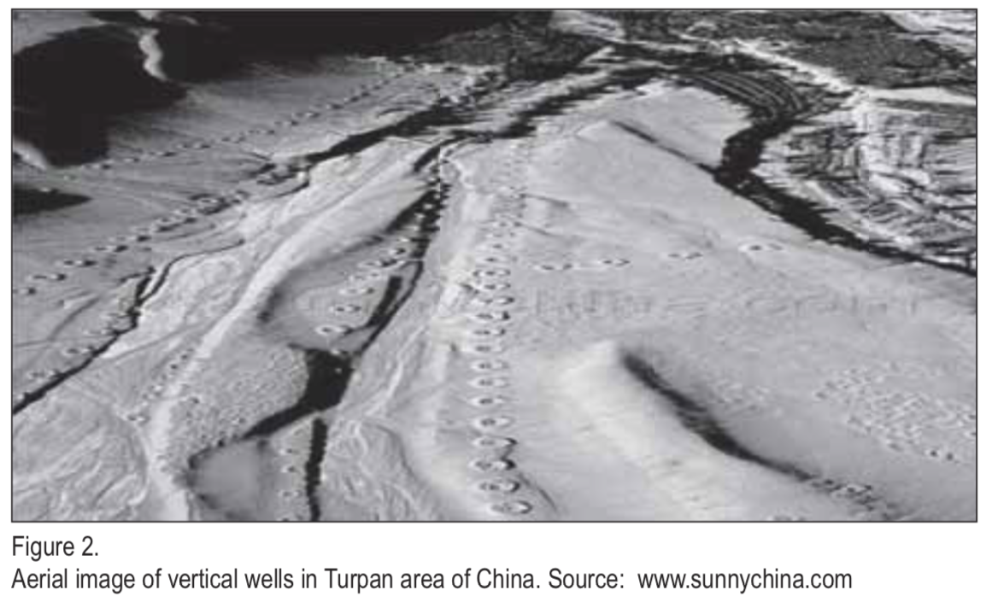
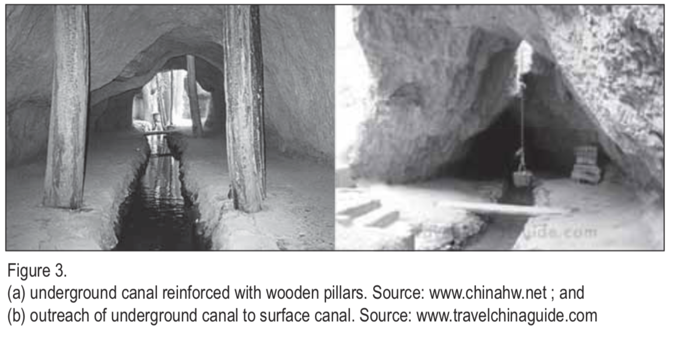

Slide 14
Earthquake Safe Traditional House Construction Practices in Kashmir
Due to the frequent occurrence of earthquakes in the Kashmir region, the people of this area have developed indigenous construction practices for earthquake safe housing. The techniques, known as “Taq” and “Dhajji-Dewari” system, have been found to have earthquake resistant qualities.
The Kashmir region lies in a high seismic hazard zone, where destructive earthquakes take place at regular intervals. On October 8, 2005, the Mw 7.6 earthquake occurring at a depth of 26 km, with epicenter at 34.6 0N, 73.0 0E near the town of Muzaffarabad, was felt throughout Pakistan and India.
In Northern India, the most severe impact of the earthquake was felt in the state of Jammu & Kashmir. The worst affected districts were Poonch in the Jammu Division and Baramula and Kupwara in the Kashmir Division.
In Northern India, the most severe impact of the earthquake was felt in the state of Jammu & Kashmir. The worst affected districts were Poonch in the Jammu Division and Baramula and Kupwara in the Kashmir Division.

Slide 15
Taq System:
In the Taq system, large pieces of wood or timber are used as horizontal runners embedded into the masonry walls. These runners are located at floor level and at the top of windows. These runners tie together all of the elements of the building or house and keep the entire structure in concert, thus preventing spreading and cracking of masonry. The runners are joined together with small pieces of timber, giving the shape of a ladder laid over a wall covering two exterior faces of the wall.
Dhajji-Dewari System:
In the Dhajji-Dewari system, timber frames for confining masonry in small parcels are used. The timber frames, not only have vertical elements, but also have cross members, which divides
the masonry infill into various small panels. The most important characteristic of this type of construction is the use of lean mud mortar. A common practice in the region is to use the Dhajji-Dewari system in the upper story walls, especially for the gable portion of the wall.

Slide 16
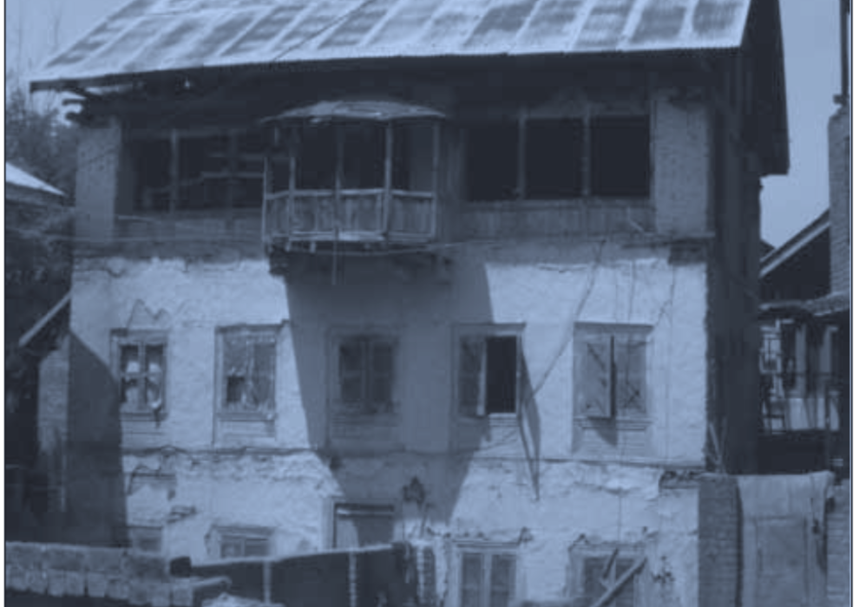


Slide 17
Indigenous Knowledge and Modern Science give Environment Friendly Shelter Solution in Flood Affected Desert Region of India
Communities living in rural Rajasthan are used to constructing houses with local materials and indigenous technology for many generations. For construction of their dhani, all the family members play a major role and have assigned responsibilities.
While the men of the family collect soil of good quality from nearby places, the womenfolk gather cow dung, which they mix with the mud to prepare the basic construction material.
The women of the family do the plasterwork for the new house, as well as for regular maintenance of the walls and floor. The roof is made by tying and weaving the dried stalk and by-product of the local Jowar crop.
The house is oriented in such a way that the wind direction and sun path ensure good ventilation and thermal comfort, which is very critical since summer temperatures in this region reach about 50º C. Normally the size of the openings is very small as it reduces heat gain and also gives less exposure to sand storms, which are a common local threat.
The people generally produce houses that are circular in plan and opt for lower heights. This is usually due to the location in the High Wind Velocity Zone where there are heavy winds especially during the summer. The circular plan helps to streamline the airflow with the least amount of resistance.

Slide 18
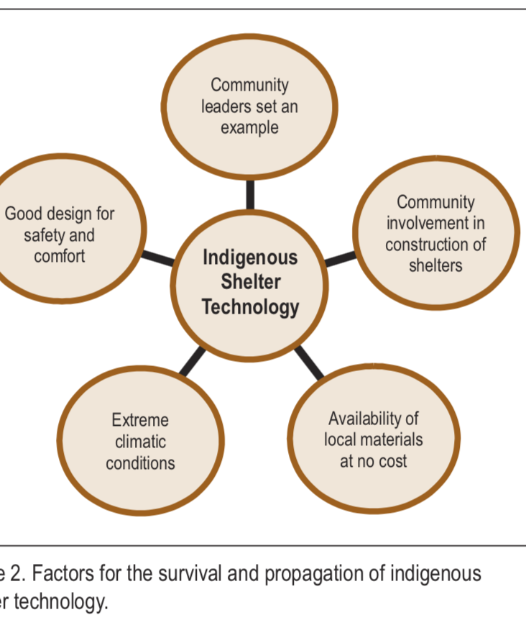
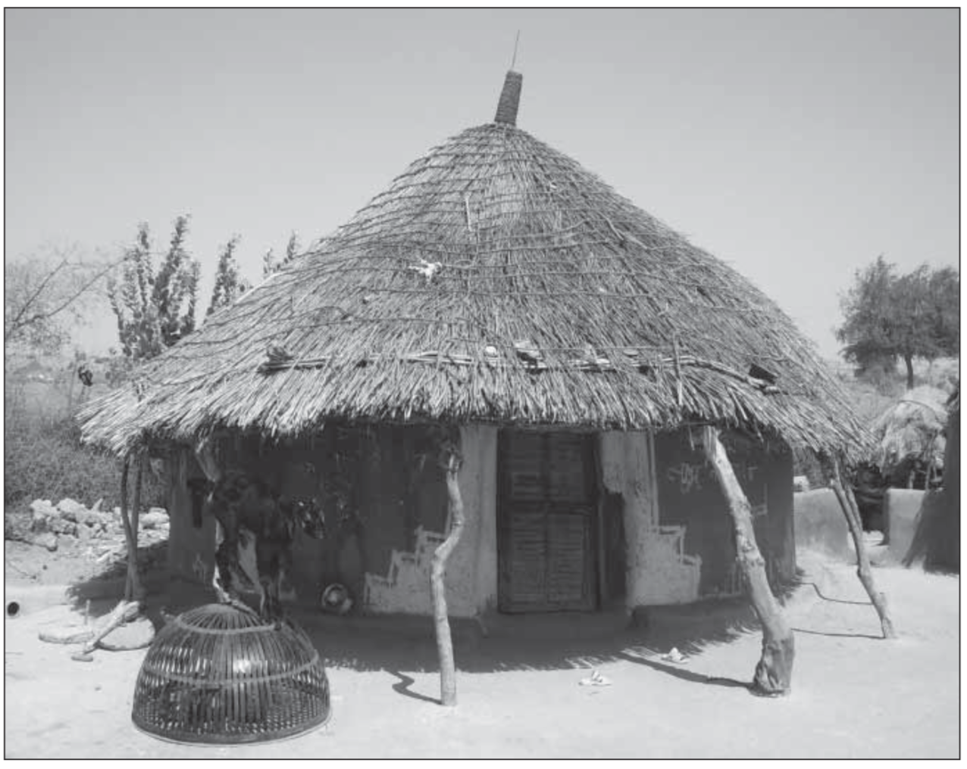
Survival and propagation of indigenous construction knowledge
There are five main factors why this technology of shelter construction is still surviving in the remote desert areas and how it is disseminated to other communities in the larger region.
1. Community leaders set an example by using this technology One very common and important tradition followed in most rural communities in India is to have a group of respected people who set an example for the rest of the community. Members of the community will often follow these leaders with regards to their behavior, choices, and general way of life. In Barmer villages, most of the respected people in the community live in Dhanis. Seeing this, therefore, other community members are encouraged to follow.
2. Community involvement in construction of shelter All of the community and family members are involved in various activities of shelter construction. Involvement of family members as well as relatives eases the burden of construction and strengthens community spirit. This is also one of the reasons this technology has survived and continues to be used in this rural and tradition-centered area.
3. Extreme climatic conditions In Barmer, summer temperatures reach as high as 50º C and in winter the night temperature is near the freezing point. Concrete houses become ovens in the heat and chillers in the cold. There is no electricity and fuel is very scarce and unaffordable for thermal control. In order to survive in these extreme conditions, an appropriate house is required. Though some people have started opting for modern materials, they are not as comfortable in these modern houses as they are in traditional ones.
4. Availability of local materials at no cost Availability of local materials, which is free of cost and transportation, is a major attraction for a community already impoverished by inadequate livelihood options and a harsh climate.
5. Good design for safety and comfort A circular shape is capable of resisting wind pressure created by sand storms and wave pressure created

Slide 19
Soil and Water Conservation through Bamboo Plantation In Nandeswar Village in Goalpara District, Assam, India
Bamboo plantation along canal bunds by the local people of Nandeswar Village in many ways has benefited their village.
With plantation of bamboo, one of Assam’s most prevalent vegetation, canal bunds (embankments) are kept from being breached and soil is kept from further erosion.
Although floods occur every year in Assam, this technique has maintained and protected embankments and has kept bridges and roads from damage during heavy rains.
The people of Nadeswar Village have learned how to cope with flood and soil erosion. They have utilized the planting of bamboo to prevent major damages.
As opposed to the past, where bamboo was grown simply for commercial purposes, this technique is a cost effective way to help local people conserve water, and stop soil and bank erosion.
The method requires less investment for repairs and maintenance of bunds, reduces siltation during heavy rains and prevents river channels from overflowing.
People have benefited from the multiple uses of bamboo through this locally developed conservation technique.
Bamboo plantation has played an important role in the livelihood and survival of the people of Nandeswar, Assam.

Slide 20
Local communities should be given the chance to determine their own destinies, to handle their own issues with their own adaptive methods.
Local households had always found ways to adapt to their changing environments without the help of DRR experts. However, the focus of government on Western knowledge forms for DRR reduces the confidence of these local households when it comes to expressing adaptation strategies that had worked for them on a larger scale.
There is also a need to understand how these households relate with their environment. It has been shown that the constant interactions between people and their environment always lead to continuous changes in the ways these people relate with the environment . Each change in climatic conditions leads to different adaptation patterns.
Relevant bodies and development initiatives should look to indigenous knowledge as a basic starting point in DRR policies especially at the local level.
The knowledge provides the necessary grassroots information, from the historic and cultural contexts, which helps in understanding how things work at the local level – this creates better engagement with local people and better policies. Provisions for documentation of indigenous knowledge should be made in the DRR literature, enabling more researchers to work towards harnessing such knowledge.

